Slide 1
CyberC 2025 – IEEE TCBD
The 17th Int. Conference on Cyber-Enabled Distributed Computing and Knowledge Discovery
A Network-based Distributed Data Storage System for Data Security in a Hostile Network
(Your paper title)
Author Name 1 and Author Name 2
Affiliation, Country, State, US
Email: author contact email address
Affiliation, Country, State, US
Email: author contact email address
InfoBeyond Technology LLC
Taiyuan, Shanxi, October 17-18, 2025

Slide 2
The Problem
Cloud Data Storing: The data are stored locally in a device at the data owner or remotely at an authorized cloud through the Internet.
Remote Data Storing: The data are stored remotely in device till the data are synchronized into the Cloud, e.g.,
Sensors are deployed in a harsh or hostile environment with limited or even no global Internet connectivity, e.g., a drone swarm.
Remote robotic mobile network while a group of robotics are deployed in an area in order to accomplish a mission in a hostile environment, e.g., land mine surveillance
Applications in a need of remote data storing:
Remote sensing
Remote operations
Environment surveillance
DoD mission operations, e.g., Land mine surveillance
Remote operations
Notes:
However, the accuracy of classification is limited due to poor and limited vision of the inspectors, and human judgment bias. Moreover, the inspection of the metal scraps is time-consuming. Aside from these, human inspectors are prone to safety risks from an accidental explosion. The advancement in X-ray technology, digital imaging, and advanced deep learning algorithms can potentially provide alternative metal scrap inspection method that is accurate, safe, and time-effective. X-ray technology, such as transmission X-rays and backscatter X-rays can see through ammo casing and cavities. Digital imaging, such as digital cameras, can capture exterior views of the metal scraps. Importantly, advanced deep learning algorithms can automatically interpret metal scrap inspection images effectively to achieve high precision to meet Department of Defense Explosive Safety Board (DDESB) requirements.

Slide 3
Remote Data Storing Security
It is problematic to assume the robotics/drones or other devices in the hostile environment are always secured or trustable.
The data could be accessed, breached, and/or disclosed when the trustworthiness of the devices is infringed.
Data confidentiality
Data authenticity
Data integrity
Data redundancy.
Traditional data storage cannot be used for remote data storing security, due to limited or intermittent or no Internet connectivity and big data generated by sensors.
Security Requirements:
Data protection against Loss: the data are maintained even if data loss occurs at one or more storing nodes.
Distributed data storage
Data resiliency: The data is protected against adversary even if t − 1 nodes are fully compromised.
Data recoverability: Data m can be recovered by an authorized user from t out of n fragments.
Notes:
However, the accuracy of classification is limited due to poor and limited vision of the inspectors, and human judgment bias. Moreover, the inspection of the metal scraps is time-consuming. Aside from these, human inspectors are prone to safety risks from an accidental explosion. The advancement in X-ray technology, digital imaging, and advanced deep learning algorithms can potentially provide alternative metal scrap inspection method that is accurate, safe, and time-effective. X-ray technology, such as transmission X-rays and backscatter X-rays can see through ammo casing and cavities. Digital imaging, such as digital cameras, can capture exterior views of the metal scraps. Importantly, advanced deep learning algorithms can automatically interpret metal scrap inspection images effectively to achieve high precision to meet Department of Defense Explosive Safety Board (DDESB) requirements.

Slide 4
Our NDDS Network Model
NDDS is an new approach to secure the data storage in hostile dynamic networks using Distributed Data Storage (DDS) method where the data is encoded into pieces and stored them in multiple devices.
NDDS Method
Polynomial-based Secret Sharing: NDDS utilizes a polynomial function to conduct secret data sharing such that the original data are encoded into a number of predefined fragments. Each fragment discloses no information about the original data. Reversely, decoding can be conducted from a t fragment without needing the polynomial function.
Fragment Distribution Blockchain: NDDS designs data storing protocols to dispatch fragments into distributed nodes in the dynamic network effectively.
Encoded data fragments are distributed in ad hoc way to multiple storage devices
Notes:
However, the accuracy of classification is limited due to poor and limited vision of the inspectors, and human judgment bias. Moreover, the inspection of the metal scraps is time-consuming. Aside from these, human inspectors are prone to safety risks from an accidental explosion. The advancement in X-ray technology, digital imaging, and advanced deep learning algorithms can potentially provide alternative metal scrap inspection method that is accurate, safe, and time-effective. X-ray technology, such as transmission X-rays and backscatter X-rays can see through ammo casing and cavities. Digital imaging, such as digital cameras, can capture exterior views of the metal scraps. Importantly, advanced deep learning algorithms can automatically interpret metal scrap inspection images effectively to achieve high precision to meet Department of Defense Explosive Safety Board (DDESB) requirements.

Slide 5
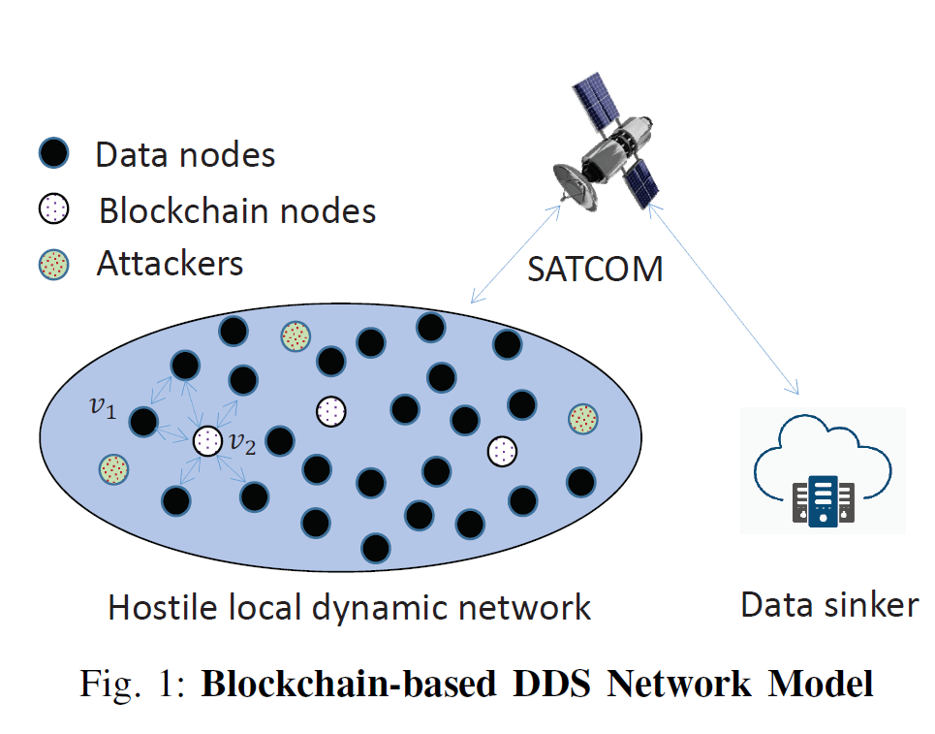
Our NDDS Network Model
NDDS Network Model
A Collection of static/mobile devices/nodes
A node may generate sensitive data
Wireless link interconnecting nodes
A node could join or leave the network anytime
Intermittent and unreliable Internet connectivity towards its data sinker
Root of trustworthy: The data sinker as the root of the trustworthy party of all nodes such that security keys can be initiated before the formulation of the local network.
Adversary & Attacks: The adversary could physically sabotage any node or compromise the node remotely to access the data in the node
Notes:
However, the accuracy of classification is limited due to poor and limited vision of the inspectors, and human judgment bias. Moreover, the inspection of the metal scraps is time-consuming. Aside from these, human inspectors are prone to safety risks from an accidental explosion. The advancement in X-ray technology, digital imaging, and advanced deep learning algorithms can potentially provide alternative metal scrap inspection method that is accurate, safe, and time-effective. X-ray technology, such as transmission X-rays and backscatter X-rays can see through ammo casing and cavities. Digital imaging, such as digital cameras, can capture exterior views of the metal scraps. Importantly, advanced deep learning algorithms can automatically interpret metal scrap inspection images effectively to achieve high precision to meet Department of Defense Explosive Safety Board (DDESB) requirements.

Slide 6
Data Encoding
Data encoding is a process in which a node encodes its sensitive data into distinguished data shares before distributed storing. A t−1 polynomial function is applied for encoding, defined by:
Eq. (1) is a polynomial function where the degree t−1 is the sharing threshold. f(x = 0) is the constant which is again equal to the integer of the data string mi. Polynomial coefficients ay for 1 ≤ y ≤ t−1 are a set of coefficients which are randomly chosen from the finite field GF(p), where p is a large prime that is greater than any coefficients.
Eq. (1) is a polynomial-based secret share function offering desirable security features. Each share generated from the Eq.(1) leaks no information regarding the data string mi. This is different from an erasure coding scheme where each fragment is plaintext without protection of the original data.
Notes:
However, the accuracy of classification is limited due to poor and limited vision of the inspectors, and human judgment bias. Moreover, the inspection of the metal scraps is time-consuming. Aside from these, human inspectors are prone to safety risks from an accidental explosion. The advancement in X-ray technology, digital imaging, and advanced deep learning algorithms can potentially provide alternative metal scrap inspection method that is accurate, safe, and time-effective. X-ray technology, such as transmission X-rays and backscatter X-rays can see through ammo casing and cavities. Digital imaging, such as digital cameras, can capture exterior views of the metal scraps. Importantly, advanced deep learning algorithms can automatically interpret metal scrap inspection images effectively to achieve high precision to meet Department of Defense Explosive Safety Board (DDESB) requirements.

Slide 7
Data Decoding
Data Decoding: Data decoding is the processing of an authorized node (e.g., the data sinker) to recover mi from t < n data shares by Lagrange Interpolation:
n-t represents reliability
Eq. (3) can be rewritten as:
Eq. (4) indicates the evaluation of the I0 is conducted without the knowledge of polynomial function in Eq. (1), e.g., the coefficients ay.
The original data can be evaluated even if any n−t shares are lost or destroyed accidentally in a hostile environment.
Notes:
However, the accuracy of classification is limited due to poor and limited vision of the inspectors, and human judgment bias. Moreover, the inspection of the metal scraps is time-consuming. Aside from these, human inspectors are prone to safety risks from an accidental explosion. The advancement in X-ray technology, digital imaging, and advanced deep learning algorithms can potentially provide alternative metal scrap inspection method that is accurate, safe, and time-effective. X-ray technology, such as transmission X-rays and backscatter X-rays can see through ammo casing and cavities. Digital imaging, such as digital cameras, can capture exterior views of the metal scraps. Importantly, advanced deep learning algorithms can automatically interpret metal scrap inspection images effectively to achieve high precision to meet Department of Defense Explosive Safety Board (DDESB) requirements.

Slide 8
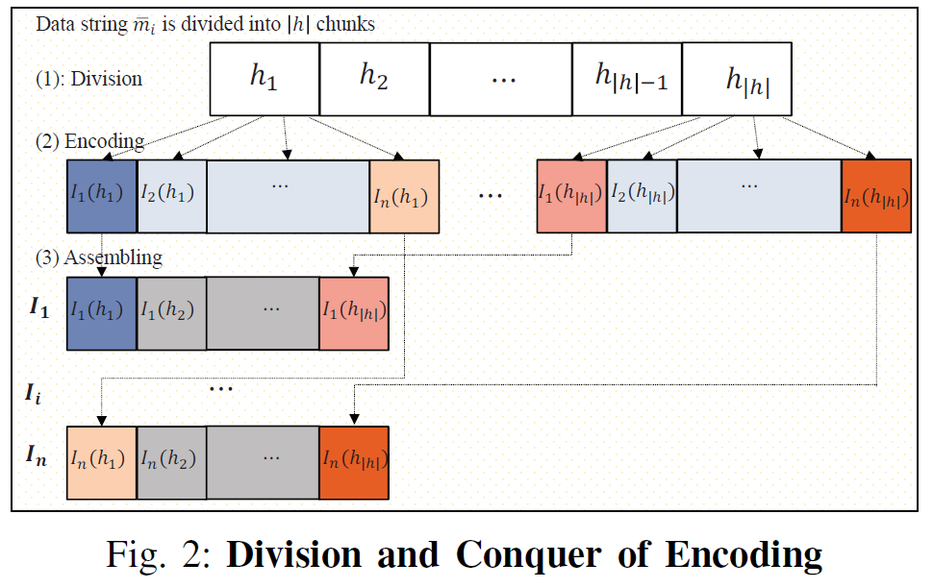
Division and Conquer
Node has limited computational resource.
The data could be large size.
A division and conquer method is designed to divide a long data string into a set of small chunks feasible for encoding and decoding operations in cheap devices.
Fig. 2 illustrates the division and conquer procedure for data encoding where the data string is first divided into a number of small chunks .
The minimal chunk is a string of one byte, corresponding to an integer between 0 and 255.
For encoding, the polynomial functions could be the same or different during chunk encoding.
Notes:
However, the accuracy of classification is limited due to poor and limited vision of the inspectors, and human judgment bias. Moreover, the inspection of the metal scraps is time-consuming. Aside from these, human inspectors are prone to safety risks from an accidental explosion. The advancement in X-ray technology, digital imaging, and advanced deep learning algorithms can potentially provide alternative metal scrap inspection method that is accurate, safe, and time-effective. X-ray technology, such as transmission X-rays and backscatter X-rays can see through ammo casing and cavities. Digital imaging, such as digital cameras, can capture exterior views of the metal scraps. Importantly, advanced deep learning algorithms can automatically interpret metal scrap inspection images effectively to achieve high precision to meet Department of Defense Explosive Safety Board (DDESB) requirements.

Slide 9
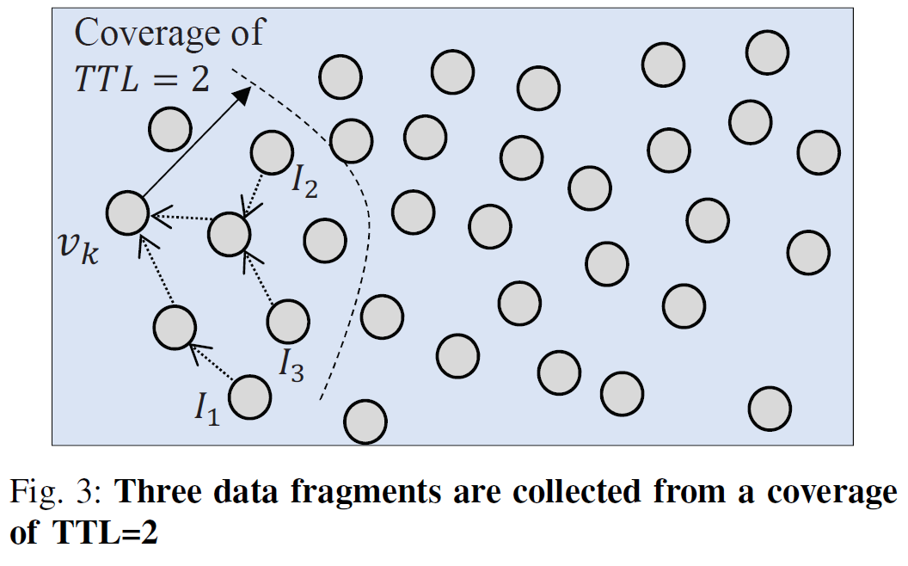
Distributed Storing/Collection
Distributed data storing is that node vi distributes its encoded data fragment I = {I1, I2, · · · , In} of data mi into n different nodes in the dynamic network.
In terms of optimal security strategy, these n nodes should be randomly selected from the network such that data shares are randomly distributed in the network.
An optimal strategy should consider the security and node mobility to minimize the data overhead in the network.
Notes:
However, the accuracy of classification is limited due to poor and limited vision of the inspectors, and human judgment bias. Moreover, the inspection of the metal scraps is time-consuming. Aside from these, human inspectors are prone to safety risks from an accidental explosion. The advancement in X-ray technology, digital imaging, and advanced deep learning algorithms can potentially provide alternative metal scrap inspection method that is accurate, safe, and time-effective. X-ray technology, such as transmission X-rays and backscatter X-rays can see through ammo casing and cavities. Digital imaging, such as digital cameras, can capture exterior views of the metal scraps. Importantly, advanced deep learning algorithms can automatically interpret metal scrap inspection images effectively to achieve high precision to meet Department of Defense Explosive Safety Board (DDESB) requirements.

Slide 10
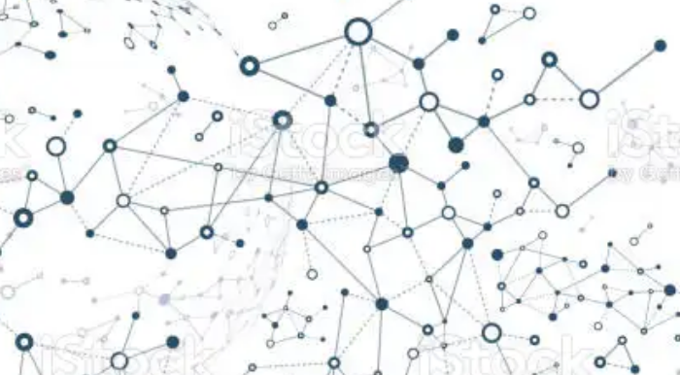
Blockchain for Distributed Data Storing
A centralized directory server in a hostile environment is subjected to security issues and single failure of point. The compromise of the directory server will result in the loss of all network data, due to disorder of the fragment index of each data file.
Nodes are selected as Blockchain nodes to implement a Blockchain-based file directory.
A blockchain is considered in the distributed data storage design to provide distributed directory services in the dynamic network. Data directory information and the records of data operational activities are stored in the blockchain as transactions.
It allows an authorized node to query and manage the network data with security.
The blockchain in the hostile and dynamic network should offer accessible directory service, tamper-proofing, and data directory confidentiality.
Notes:
However, the accuracy of classification is limited due to poor and limited vision of the inspectors, and human judgment bias. Moreover, the inspection of the metal scraps is time-consuming. Aside from these, human inspectors are prone to safety risks from an accidental explosion. The advancement in X-ray technology, digital imaging, and advanced deep learning algorithms can potentially provide alternative metal scrap inspection method that is accurate, safe, and time-effective. X-ray technology, such as transmission X-rays and backscatter X-rays can see through ammo casing and cavities. Digital imaging, such as digital cameras, can capture exterior views of the metal scraps. Importantly, advanced deep learning algorithms can automatically interpret metal scrap inspection images effectively to achieve high precision to meet Department of Defense Explosive Safety Board (DDESB) requirements.

Slide 11
NDDS Attacks and Security Analysis
For NDDS security analysis, we assume the blockchain and the data sinker are both secure and all possible security attacks against them are addressed. NDDS prevents the following attacks:
Malicious behaviors from an adversary could be conducted in order to compromise the data or disrupt the data availability from access of an authorized node, e.g., Eavesdropping
A device could be physically seized or compromised via cyber attacks such that the adversary is able to access all fragments stored in the device.
An adversary is able to take advantage of a dynamic wireless network to perform byzantine distributed data attacks.
The adversary can then act as an intermediate node on the end-to-end path between the data source node and storage node.
As a relay node of the fragments, the adversary can hereafter capture, drop, or modify the data fragments before delivering them to the next hop towards the destination storage node.
Notes:
However, the accuracy of classification is limited due to poor and limited vision of the inspectors, and human judgment bias. Moreover, the inspection of the metal scraps is time-consuming. Aside from these, human inspectors are prone to safety risks from an accidental explosion. The advancement in X-ray technology, digital imaging, and advanced deep learning algorithms can potentially provide alternative metal scrap inspection method that is accurate, safe, and time-effective. X-ray technology, such as transmission X-rays and backscatter X-rays can see through ammo casing and cavities. Digital imaging, such as digital cameras, can capture exterior views of the metal scraps. Importantly, advanced deep learning algorithms can automatically interpret metal scrap inspection images effectively to achieve high precision to meet Department of Defense Explosive Safety Board (DDESB) requirements.

Slide 12
NDDS Security Operational Efficiency
Experiments are conducted to test NDDS efficiency implemented in different mobile devices which has limited computational resources.
Consider an Arduino equipped with a 8-bit microprocessor of 16 MHz and 32k RAM. is applied for fragment encoding. Suppose the data is divided into chunks in size of 64 bytes in sequence and Division/Conquer.
The total overhead to execute an AES 128 encryption, decryption, SHA3-512 hash, and verification of a data chunk is approximately 61.34 ms, which looks high due to very low hardware configuration.
The overhead is quickly reduced to 0.329 ms when the operations are implemented in a Raspberry Pi configured with a 64-bit microprocessor of 1G MHz and 2GB RAM.
Notes:
However, the accuracy of classification is limited due to poor and limited vision of the inspectors, and human judgment bias. Moreover, the inspection of the metal scraps is time-consuming. Aside from these, human inspectors are prone to safety risks from an accidental explosion. The advancement in X-ray technology, digital imaging, and advanced deep learning algorithms can potentially provide alternative metal scrap inspection method that is accurate, safe, and time-effective. X-ray technology, such as transmission X-rays and backscatter X-rays can see through ammo casing and cavities. Digital imaging, such as digital cameras, can capture exterior views of the metal scraps. Importantly, advanced deep learning algorithms can automatically interpret metal scrap inspection images effectively to achieve high precision to meet Department of Defense Explosive Safety Board (DDESB) requirements.

Slide 13
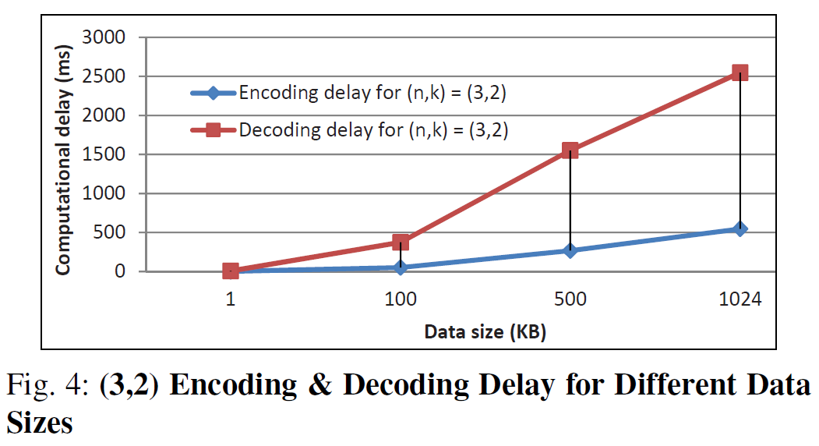
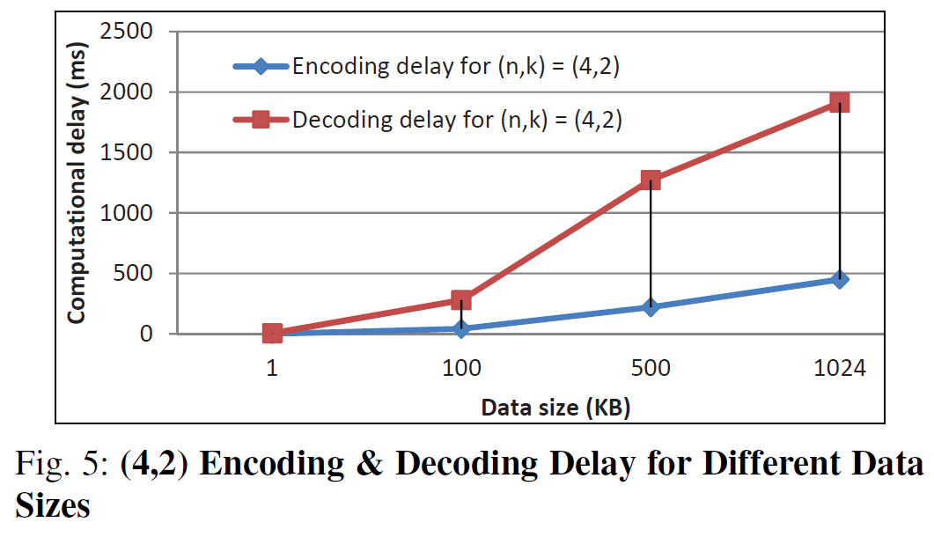
NDDS Security Operational Efficiency
(3,2) means a data file is encoded into 3 fragments and 2 fragments among them allow the recovery of original data.
Both the encoding and decoding delays increase with the data size, e.g., from 1 kb to 1024 kb in the experiment.
(4,2) means a data file is encoded into 4 fragments and 2 fragments among them allow the recovery of original data.
The decoding delay is higher than the encoding delay.
Notes:
However, the accuracy of classification is limited due to poor and limited vision of the inspectors, and human judgment bias. Moreover, the inspection of the metal scraps is time-consuming. Aside from these, human inspectors are prone to safety risks from an accidental explosion. The advancement in X-ray technology, digital imaging, and advanced deep learning algorithms can potentially provide alternative metal scrap inspection method that is accurate, safe, and time-effective. X-ray technology, such as transmission X-rays and backscatter X-rays can see through ammo casing and cavities. Digital imaging, such as digital cameras, can capture exterior views of the metal scraps. Importantly, advanced deep learning algorithms can automatically interpret metal scrap inspection images effectively to achieve high precision to meet Department of Defense Explosive Safety Board (DDESB) requirements.

Slide 14
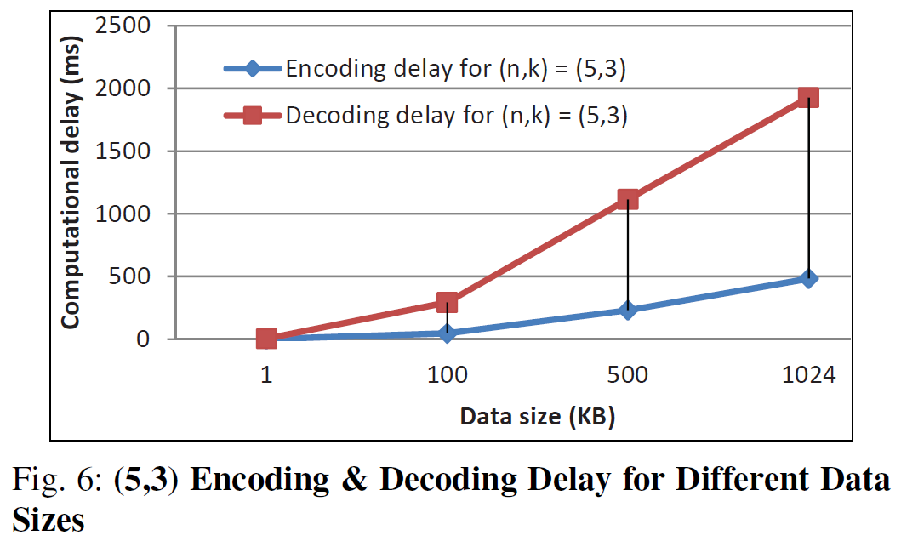
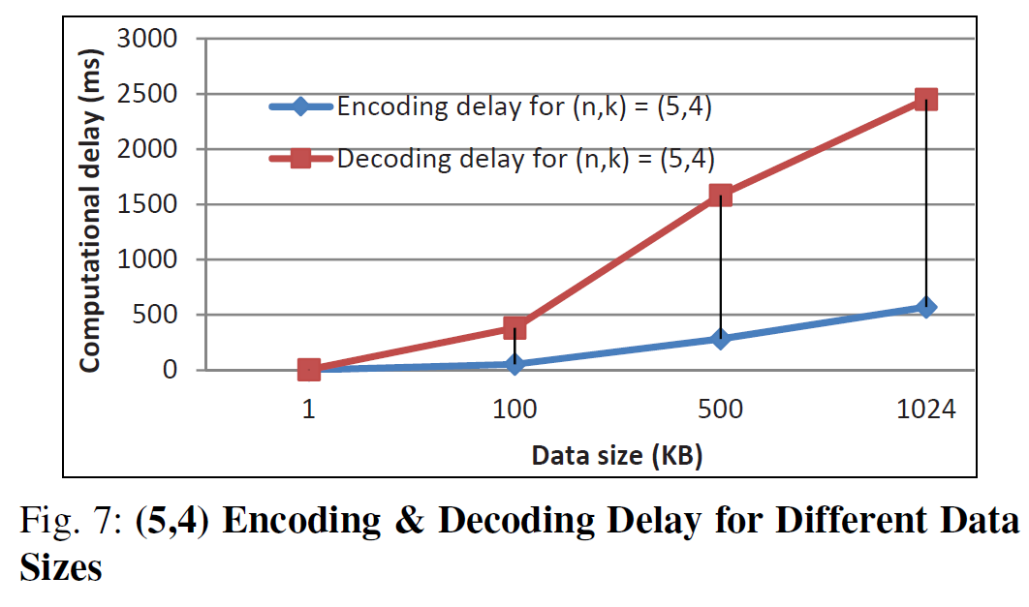
NDDS Security Operational Efficiency
(5,3) means a data file is encoded into 5 fragments and 3 fragments among them allow the recovery of original data.
Both the encoding and decoding delays increase with the data size, e.g., from 1 kb to 1024 kb in the experiment.
(5,4) means a data file is encoded into 5 fragments and 4 fragments among them allow the recovery of original data.
The decoding delay increases with the number of required fragments to recovery the data, e.g., 3 in Fig. 6 and 4 in Fig.7.
Notes:
However, the accuracy of classification is limited due to poor and limited vision of the inspectors, and human judgment bias. Moreover, the inspection of the metal scraps is time-consuming. Aside from these, human inspectors are prone to safety risks from an accidental explosion. The advancement in X-ray technology, digital imaging, and advanced deep learning algorithms can potentially provide alternative metal scrap inspection method that is accurate, safe, and time-effective. X-ray technology, such as transmission X-rays and backscatter X-rays can see through ammo casing and cavities. Digital imaging, such as digital cameras, can capture exterior views of the metal scraps. Importantly, advanced deep learning algorithms can automatically interpret metal scrap inspection images effectively to achieve high precision to meet Department of Defense Explosive Safety Board (DDESB) requirements.

Slide 15
Thank you!
Visit us:
https://derock.dev/
https://poroscout.gg/
Notes:
However, the accuracy of classification is limited due to poor and limited vision of the inspectors, and human judgment bias. Moreover, the inspection of the metal scraps is time-consuming. Aside from these, human inspectors are prone to safety risks from an accidental explosion. The advancement in X-ray technology, digital imaging, and advanced deep learning algorithms can potentially provide alternative metal scrap inspection method that is accurate, safe, and time-effective. X-ray technology, such as transmission X-rays and backscatter X-rays can see through ammo casing and cavities. Digital imaging, such as digital cameras, can capture exterior views of the metal scraps. Importantly, advanced deep learning algorithms can automatically interpret metal scrap inspection images effectively to achieve high precision to meet Department of Defense Explosive Safety Board (DDESB) requirements.

